Slide 1
Design a NOT gate using System Verilog
By
GOMATHI DURGA S
ECE DEPARTMENT
FRANCIS XAVIER ENGINEERING COLLEGE

Slide 2
SYSTEM VERILOG
System Verilog is a powerful hardware description language used for the design and verification of complex digital systems. It provides a robust set of features for both design and testbench development, enabling efficient and reliable circuit implementation.
The design file contains the implementation of the digital logic, utilizing System Verilog constructs such as modules, ports, and behavioral descriptions.
The testbench file is responsible for stimulating the design, verifying its functionality, and reporting any discrepancies between the expected and actual behavior.
DESIGN & TESTBENCH

Slide 3
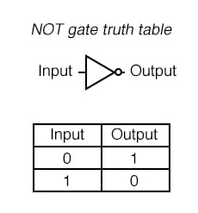
NOT GATE
A NOT gate, also known as an inverter, is one of the basic logic gates in digital electronics. It has one input and one output, and its function is to invert or reverse the input signal.
If the input is 1 (high or true), the output will be 0 (low or false).
If the input is 0 (low or false), the output will be 1 (high or true).

Slide 4
If you have any queries,
sgomathidurga23@gmail.com

Slide 5
THANK YOU!!!

